Slide 1
MAD3125 ANDROID DEVELOPMENT FUNDAMENTALS
FINAL PROJECT PRSENTATION

Slide 2
TEAM INFORMATION
Product Owner :
Jigisha Patel
Team Members :
Sarbjit Kaur(728009)
Shehnaaz(738011)
Harpreet Kaur(738219)

Slide 3
INTRODUCTION
ANDROID
Android Studio is an integrated development environment (IDE) from Google that provides developers with tools needed to build applications for the Android OS platform.
The Android Studio IDE is free to download and use.
It has a rich UI development environment with templates to give new developers a launching pad into Android development.
Developers will find that Studio gives them the tools to build phone and tablet solutions as well as emerging technology solutions for Android TV, Android Wear, Android Auto, Glass and additional contextual models.
Android Studio is intended to be used by development teams as small as one person or as large as global teams.
Android solutions can be developed using either Java or C++ in Android Studio.

Slide 4
Online movie ticket booking
The main objective of the project is to manage the details of Movies,Tickets booking,Show timigs,Customer.
It manages all the information about Movie,Customer,Movie theatre.
The purpose of the project is to build an application program to reduce the manual work for managing the movie.
It provides the searching facilities based on various factors, such as Movie Booking, Show Timing,Location.

Slide 5
SPRINT planned
SPRINT 1 | SPRINT 2 | SPRINT 3 | SPRINT 4
23 June 2018 Saturday | 27 June 2018 Wednesday | 03 July 2018 Tuesday | 07 July 2018 Saturday
Logo (MovieTicket) Start Page Design Login Page Design User Registration Design | Movie Search Theatre Search Validation Database Connection | List of Movies Location facility | Contact us Logout

Slide 6
TOOLS AND TECHNOLOGIES USED
TOOLS
Android Studio
TECHNOLOGIES
MySql
Database
Android

Slide 7
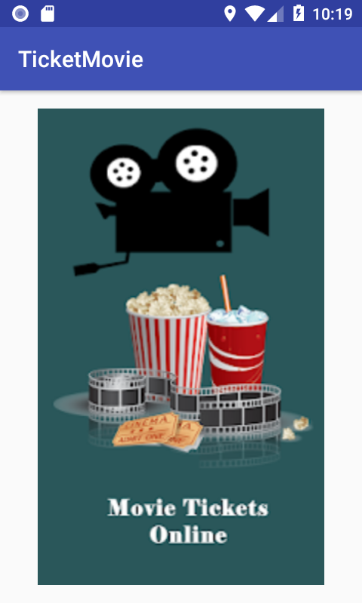
SCREEN 1
We have created a Application in which User can choose theatre, screen of their own choice and book their ticket for movie.

Slide 8
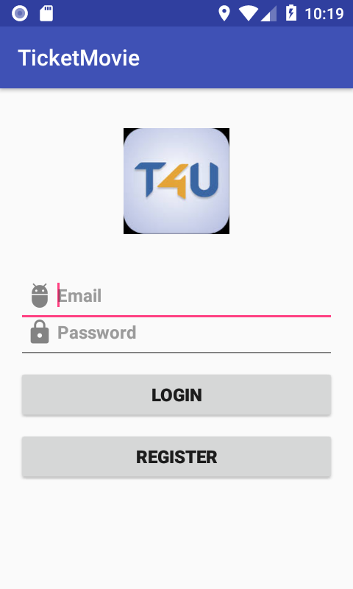
SCREEN 2
New user can register by inserting their details and Login here.

Slide 9
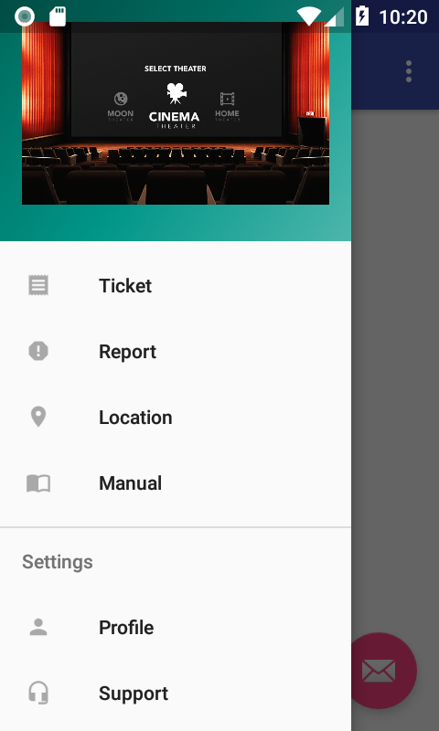
Screen 3

Slide 10
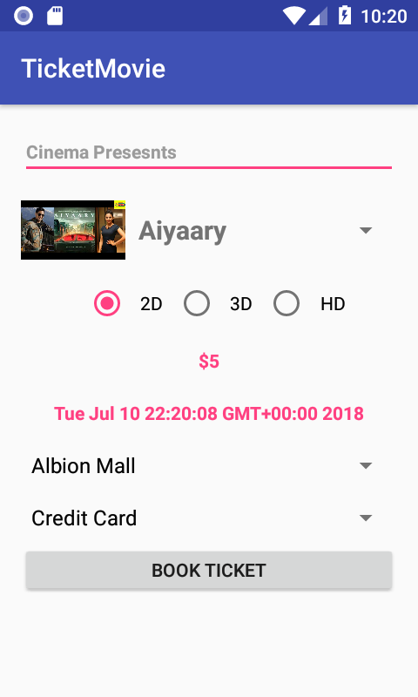
SCREEN 4
User can select the movie , theatre and screen of their own choice

Slide 11
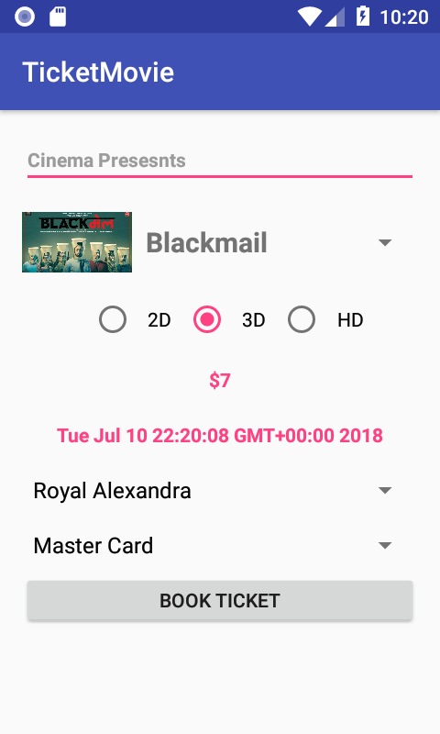
SCREEN 5

Slide 12
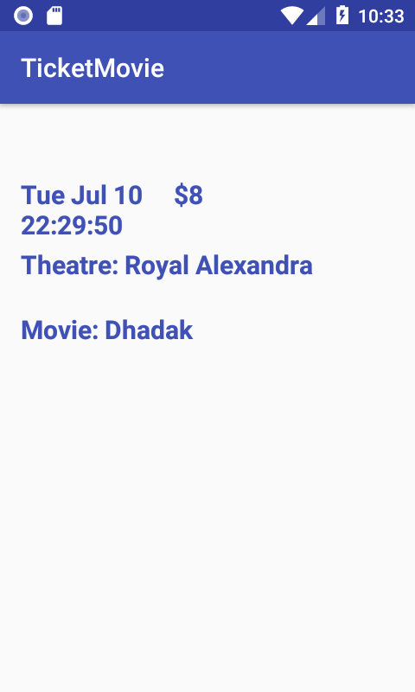
SCREEN 6
Shows the details of booked ticket.

Slide 13
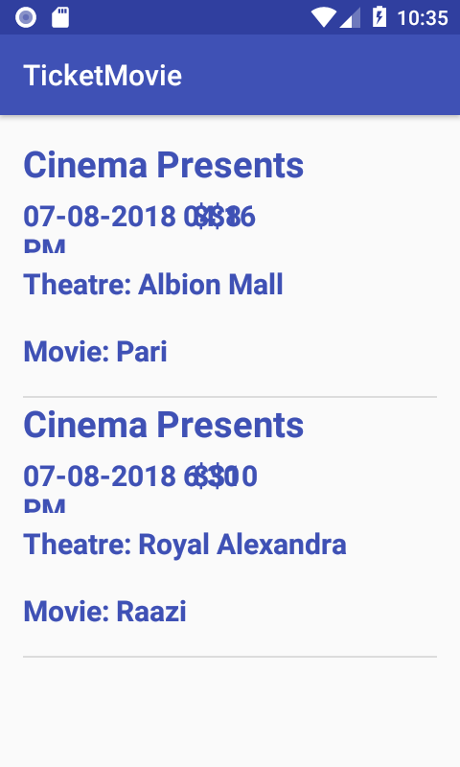
SCREEN 7

Slide 14
SPRINT FOLLOWED
SPRINT 1 | SPRINT 2 | SPRINT 3 | SPRINT 4
23 June 2018 Saturday | 27 June 2018 Wednesday | 03 June 2018 Tuesday | 07 July 2018 Saturday
Logo(Movie Ticket) Start Page Design Login Page Design User Registration Design | Movie Search Theatre Search Validation | List of Movies Database Connection Location facility | Contact us Logout

Slide 15
DIFFICULTIES FACED AND LESSONS LEARNT
DIFFICULTIES FACED :
Inserting data in custom list view from database.
LESSONS LEARNT :
Team work
Plan the things first before you implement.

Slide 16
REFERENCES
https://www.quora.com/
https://stackoverflow.com/
https://developer.android.com/
https://www.youtube.com/android/
https://www.javatpoint.com/android-tutorial/

Slide 17


